Slide 1
CST8250
Normalization
Week 3

Slide 2
Overview
Data normalization defined
Anomalies
Normal forms
Steps to normalization
Examples

Slide 3
Data Normalization
Primarily a tool to validate and improve a logical design so that it satisfies certain constraints that avoid unnecessary duplication of data
The process of decomposing relations with anomalies to produce smaller, well-structured relations
Notes:
The previous slide deck showed how to map an E-R model to a relational database design. If you follow these mappings, then your result will be a well-structured database. But if you just start by creating tables without considering the ER rules, then you will likely get a database that is not well-structured. These databases could cause anomalies because of data duplication. In the next several slides we’ll see how to correct these anomalies through a process called “normalization”.

Slide 4
Anomalies

Slide 5
Well-Structured Relations
A relation that contains minimal data redundancy and allows users to insert, delete, and update rows without causing data inconsistencies
Goal is to avoid anomalies
Anomaly: problem in un-normalized databases
General rule of thumb: A table should not pertain to more than one entity type.

Slide 6
Type of Anomalies
Insertion Anomaly
Deletion Anomaly
Update / Modification Anomaly
adding new rows forces user to create duplicate data
deleting rows may cause a loss of data that would be needed for other future rows
changing data in a row forces changes to other rows because of duplication

Slide 7

Example
Question–Is this a relation?
Answer–Yes: Unique rows and no multivalued attributes
Question–What’s the primary key?
Answer–Composite: EmpID, CourseTitle

Slide 8
Anomalies in this Table
Insertion–can’t enter a new employee without having the employee take a class (or at least empty fields of class information)
Deletion–if we remove employee 140, we lose information about the existence of a Tax Acc class
Update–giving a salary increase to employee 100 forces us to update multiple records
Why do these anomalies exist?
Because there are two entities (Employee and Course) in this one relation. This results in data duplication and an unnecessary dependency between the entities.

Slide 9
Why should we remove anomalies?
The main function of a database is to STORE and RETRIEVE information. We need to be able to do this efficiently and accurately.
A database that is not well formed is prone to the following issues due to anomalies:
Efficiency - increased query time
Data integrity – missing, inaccurate, and duplicate information
Ease of use - increased effort in writing queries to store and retrieve data

Slide 10
Normal Forms

Slide 11
Normal Forms
We want to REDUCE REDUDANCY and REMOVE ANOMALIES.
Our goal is to get to 3rd or Boyce-Codd normal form in order to achieve the above
We achieve the normal forms by resolving dependencies – our focus is on the keys of the tables
Recall strong vs weak entities – we will be creating foreign key relationships to resolve these issues

Slide 12
Functional Dependencies and Keys
Functional Dependency
The value of one attribute (the determinant) determines the value of another attribute
Candidate Key:
A unique identifier. One of the candidate keys will become the primary key
E.g., perhaps there is both credit card number and SIN# in a table, in this case both are candidate keys.
Each non-key field is functionally dependent on every candidate key.

Slide 13
First Normal Form
No multivalued attributes
Every attribute value is atomic

Slide 14
First Normal Form
No multivalued attributes
Recall multivalued attributes are lists
Storing a list in a database means duplicate data and empty/null entries
Every attribute value is atomic

Slide 15
First Normal Form (cont.)
No multivalued attributes
empId | name | skill
12345 | Arthur McArthur | Java
 |  | C++
23456 | John Johnson | Python
34567 | Alice McAllison | Javascript
 |  | Python
Employee table contains NULL values, skill is a list

Slide 16
First Normal Form (cont.)
No multivalued attributes
empId | name | skill
12345 | Arthur McArthur | Java
12345 | Arthur McArthur | C++
23456 | John Johnson | Python
34567 | Alice McAllison | Javascript
34567 | Alice McAllison | Python
Employee table now has redundancy - duplicate data
Table is in 1st Normal Form (1NF), but we cannot count rows as there is duplicate data

Slide 17
Second Normal Form
1NF PLUS every non-key attribute is fully functionally dependent on the ENTIRE primary key
Every non-key attribute must be defined by the entire key, not by only part of the key
No partial functional dependencies

Slide 18
Second Normal Form (cont.)
No multivalued attributes
Partial dependencies removed
likely have two entities in one table
studentId | courseId | courseName
987654321 | CST8110 | Intro to Programming
123456789 | CST8110 | Intro to Programming
123456789 | CST8250 | Database Design and Administration
studentId is dependent on courseId
studentId -> courseId

Slide 19
Second Normal Form (cont.)
No multivalued attributes
Partial dependencies removed
likely have two entities in one table
studentId | courseId
987654321 | CST8110
123456789 | CST8250
Tables are now in 2NF
courseId | courseName
CST8110 | Intro to Programming
CST8250 | Database Design and Administration

Slide 20
Third Normal Form
2NF PLUS no transitive dependencies (functional dependencies on non-primary-key attributes)
Note: This is called transitive, because the primary key is a determinant for another attribute, which in turn is a determinant for a third
Solution: Non-key determinant with transitive dependencies go into a new table; non-key determinant becomes primary key in the new table and stays as a foreign key in the old table
a -> b and b -> c therefore a -> c

Slide 21
Third Normal Form (cont.)
No multivalued attributes
Partial dependencies removed
Transitive dependencies removed
siteId | contractor | fee
123 | ABC Company | 300
234 | XYZ Company | 500
siteId -> contractor
and contractor -> fee
therefore siteId -> fee

Slide 22
Third Normal Form (cont.)
No multivalued attributes
Partial dependencies removed
Transitive dependencies removed
siteId | contractor
123 | ABC Company
234 | XYZ Company
contractor | fee
ABC Company | 300
XYZ Company | 500
Now in 3NF
NOTE: Generally 3NF is either enough or also achieves BCNF in cases like the above

Slide 23
Boyce-Codd Normal Form (BCNF)
Relation has more than one candidate key, anomalies may result even though that relation is in 3NF.
A relation is in Boyce-Codd normal form (BCNF) if and only if every determinant in the relation is a candidate key.
Simply put, a relation is in BCNF when every attribute/field depends on the key and nothing but the key.

Slide 24
Boyce-Codd Normal Form (BCNF)
Revisit 3NF tables
Simply put, a relation is in BCNF when every attribute/field depends on the key and nothing but the key.
siteId | contractor
123 | ABC Company
234 | XYZ Company
contractor | fee
ABC Company | 300
XYZ Company | 500
Contractor table does not have a key, will need to add as name isn’t unique enough

Slide 25
Boyce-Codd Normal Form (BCNF)
Revisit 3NF tables
Simply put, a relation is in BCNF when every attribute/field depends on the key and nothing but the key.
siteId | contractorId
123 | 1
234 | 2
contractorId | contractorName | fee
1 | ABC Company | 300
2 | XYZ Company | 500
Now in BCNF

Slide 26
Steps to Normalization, Example

Slide 27
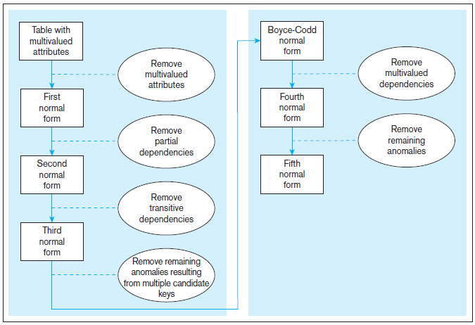
Steps in Normalization
3rd normal form is generally considered sufficient

Slide 28
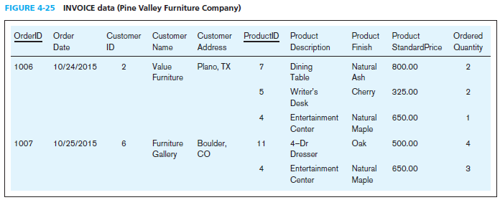
Normalization Example
Table with multivalued attributes, not in 1st normal form
Note: This is NOT a relation.

Slide 29
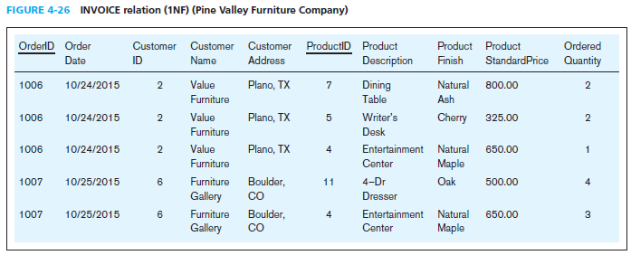
Normalization Example (cont.)
Table with no multivalued attributes and unique rows, in 1st normal form
Note: This is a relation, but not a well-structured one.

Slide 30
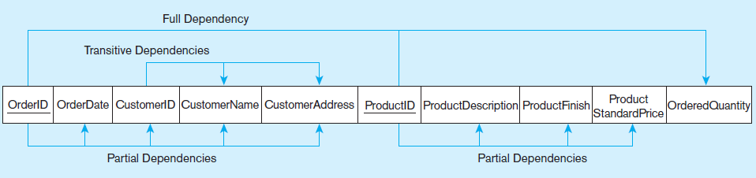
Normalization Example (cont.)
Functional dependency diagram for INVOICE
OrderID ➔ OrderDate, CustomerID, CustomerName, CustomerAddress
CustomerID ➔ CustomerName, CustomerAddress
ProductID ➔ ProductDescription, ProductFinish, ProductStandardPrice
OrderID, ProductID ➔ OrderQuantity
Therefore, NOT in 2nd Normal Form

Slide 31
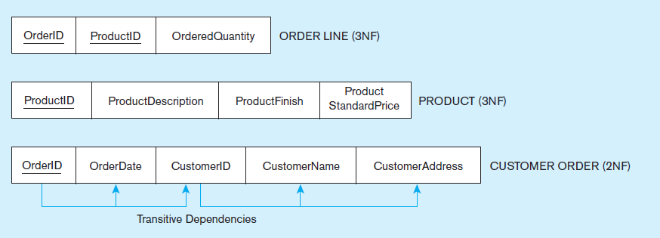
Normalization Example (cont.)
Removing partial dependencies
Getting it into Second Normal Form
Partial dependencies are removed, but there are still transitive dependencies

Slide 32
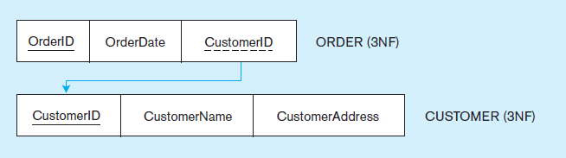
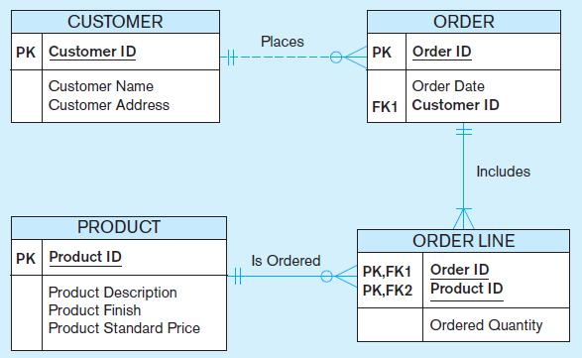
Normalization Example (cont.)
Removing partial dependencies
Getting it into Third Normal Form
Transitive dependencies are removed.
Figure 4-30 shows the result of normalization, yielding four separate relations where initially there was only one.

Slide 33
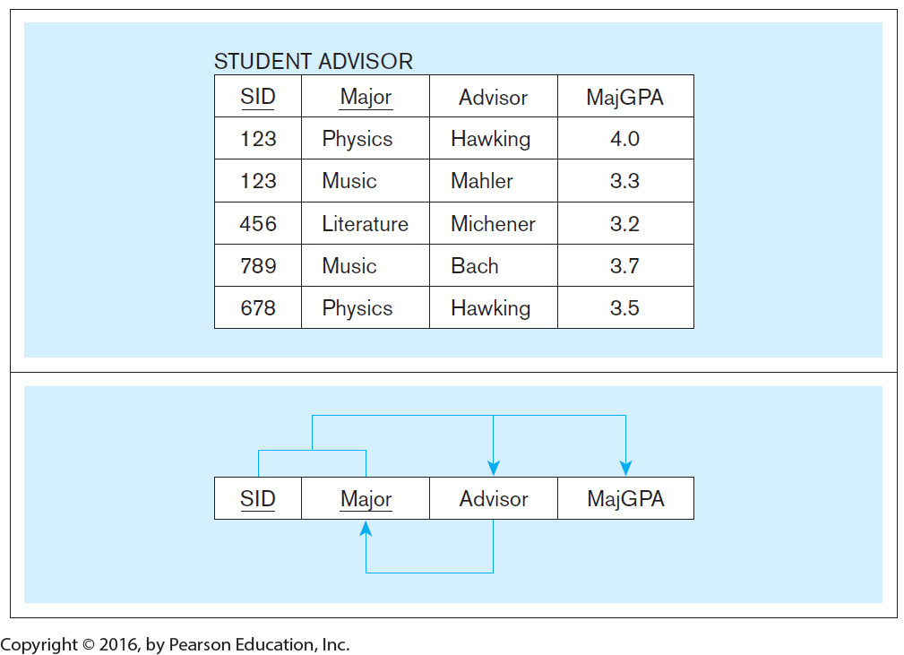
Normalization Example 2: Table in 3NF but not in BCNF
Table is in 3NF
Functional Dependencies

Slide 34
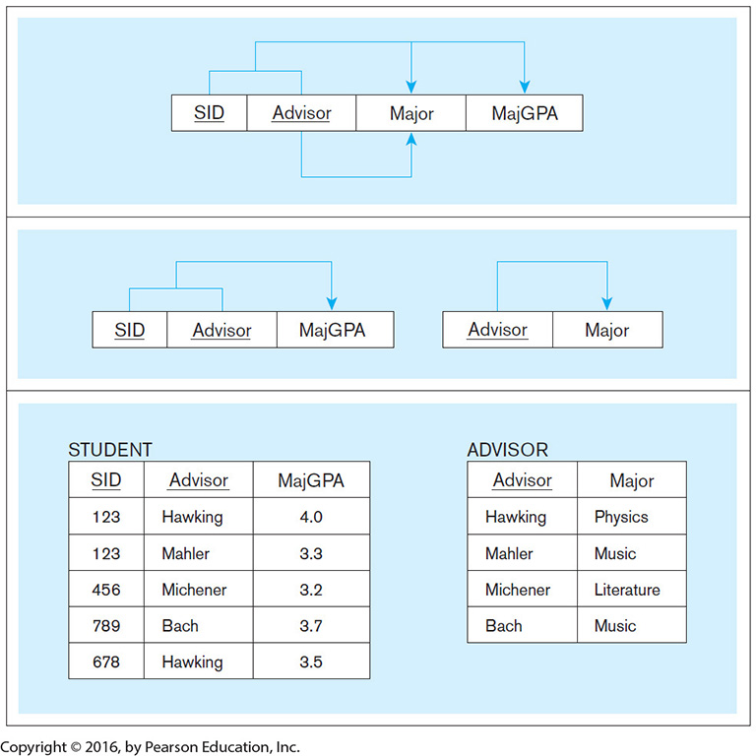
Normalization Example 2 (cont.): Turning it into BCNF
Functional Dependencies
Tables are in BCNF
Sample Data

Slide 35
Questions?

